Slide 1


GitHub Copilot Masterclass Harness AI to Code Better

Slide 2

GitHub Copilot क्या है
What is GitHub Copilot?
GitHub Copilot is an AI-powered coding assistant designed to help developers write code more efficiently. It functions as an AI pair programmer, providing real-time code suggestions and completions within various integrated development environments (IDEs) like Visual Studio Code, Visual Studio, and JetBrains products.

Slide 3
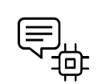








Key Concepts Behind AI and Copilot
4 Key Concepts Behind Copilot
NLP
LLM
ML
Context
"cat"
[0.21, 0.89, …]

Slide 4




Key Concepts Behind AI and Copilot
User
Prompt
AI
Graph
Context
Result
How Copilot Works
You Give Natural Language Prompt
AI takes prompt
AI takes Context Provided
Generates Human-like Responses

Slide 5

VS Code क्या है
What is VS Code?
VS Code, or Visual Studio Code, is a free and powerful source-code editor developed by Microsoft for Windows, macOS, and Linux.

Slide 6




Setting Up copilot in VS Code
Download Vs code
Setup VS Code
Install Github Copilot Extension
Start Writing Code

Slide 7


VS Code मे Copilot
Copilot in VS Code Will help you in:
Inline Code Suggestion
Code Completion
Vibe Coding
Agentic code Generation

Slide 8
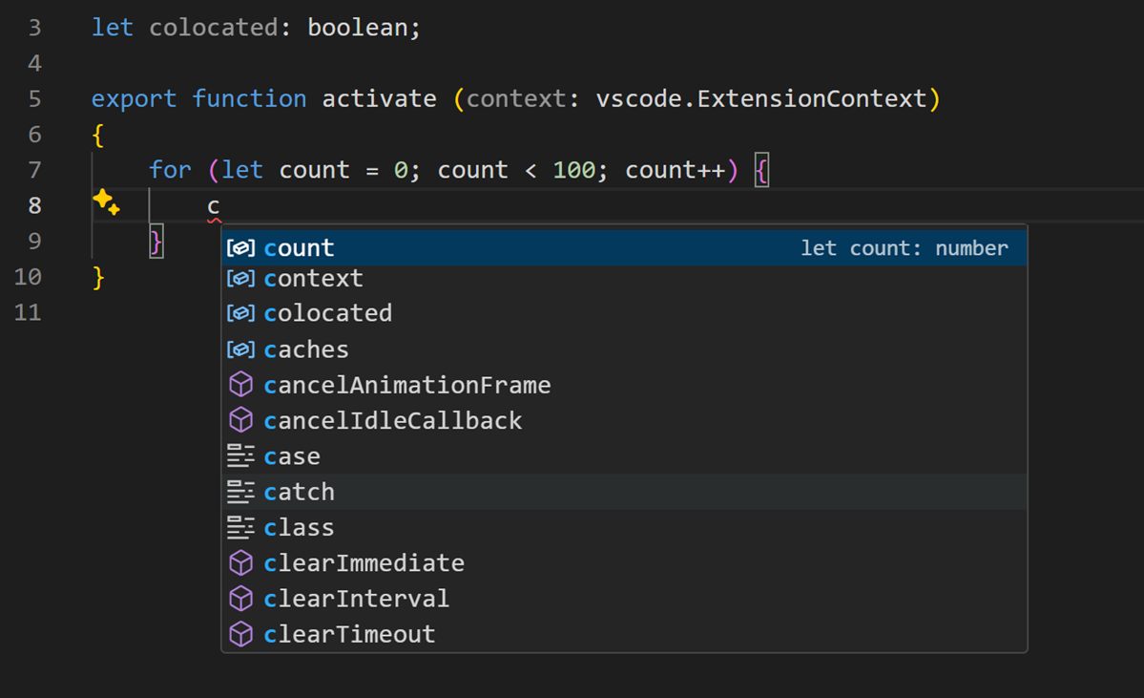
Contextual AI Assistance
Code Predictions & Completion

Slide 9
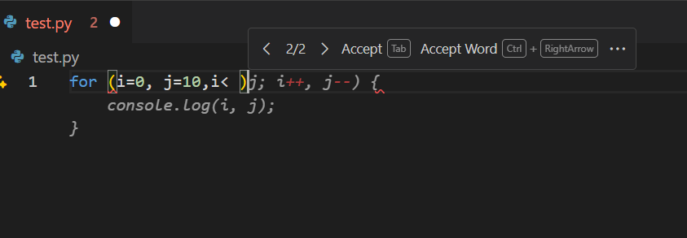
Copilot Inline Code Suggestions
inline suggestions appear as ghost text while you type and offer completions.
Example: type "for (let i=0; i<" and watch Copilot propose loop templates.
Accept suggestions with Tab; cycle through alternatives with Alt+[ or Alt+]; dismiss with Esc.
Tip: you can partially accept a suggestion then edit the remainder to fit your style. Balance Copilot suggestions with your own coding intent and conventions.

Slide 10
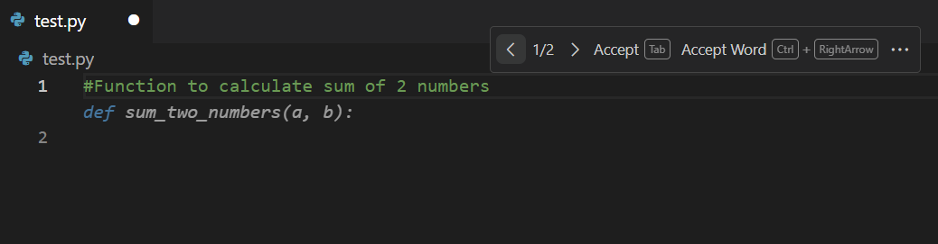
Prompts & Hints: Ask Better
Write descriptive comments above your code to guide Copilot toward the desired result.
Include constraints, inputs and expected outputs for clarity in your hints.
Provide small examples (input → output pairs) to help Copilot infer patterns. Iteratively refine prompts when suggestions don’t meet your needs. Use present tense and active voice for increased comprehension.

Slide 11
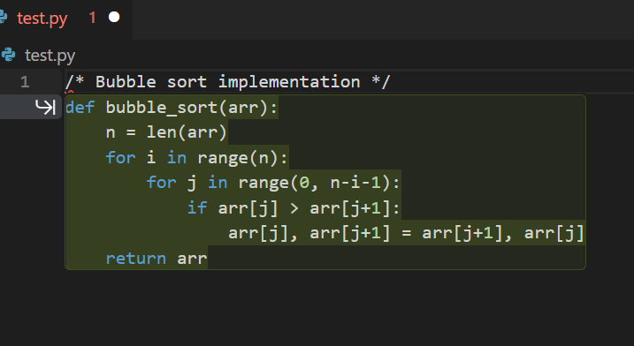
Loops, Functions & Classes Generation
Copilot can generate loops, helper functions and complete classes from descriptive comments.
Example: write a comment "/* Bubble sort implementation */" to get a full function.
Review generated code for edge cases and validate inputs and outputs. Refactor repetitive constructs and rename variables for readability. Add docstrings or type hints to influence the function signature.

Slide 12




Multi‑Language Support
Copilot supports many languages: Python, JavaScript/TypeScript, C++, Go, Rust and more.
Switch languages simply by changing the file extension; suggestions adapt automatically.
Example: ask for a list comprehension in Python or a vector manipulation in C++.
Be aware of language‑specific library choices and adjust accordingly. Always run or compile the code to validate correctness before merging.

Slide 13
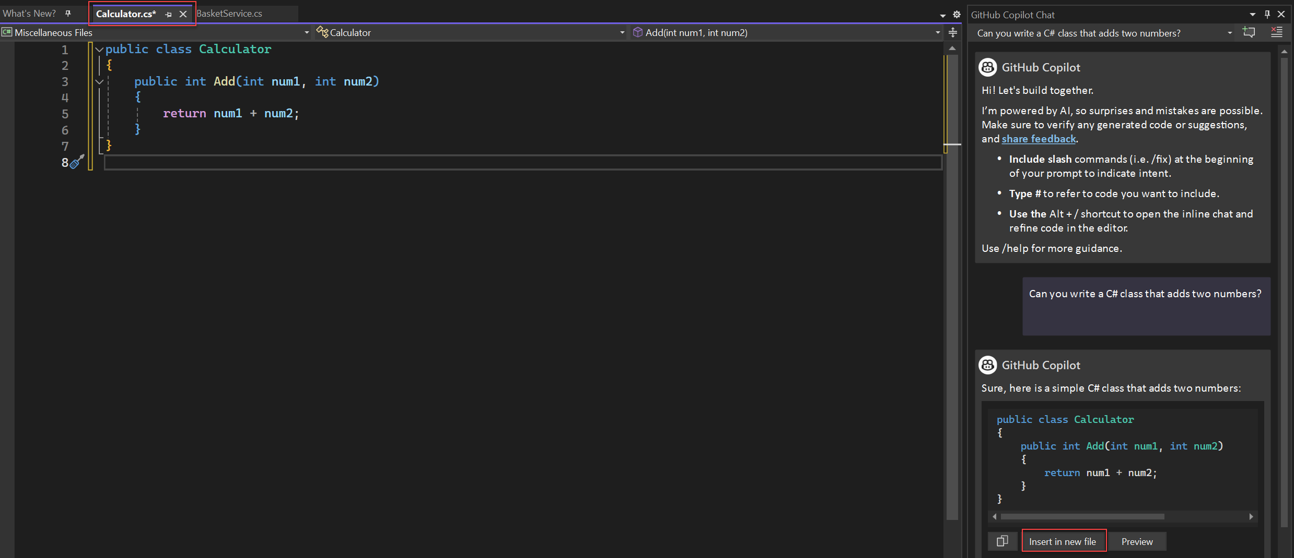
GitHub Copilot Chat
आपका AI Programming Assistant

Slide 14
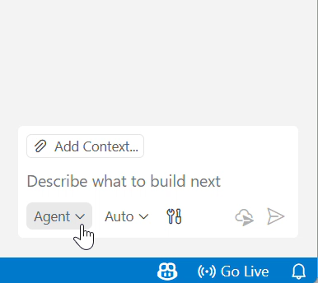
Github Copilot Chat क्या है
Github Copilot Chat is an interactive assistant that understands your context and respond accordingly.
Enable Chat by clicking the Copilot icon or running the "Copilot: Chat" command from the Command Palette.
Chat uses the contents of your open files and selection to provide tailored responses. Chat has 4 Modes :
Agent (Default)
Ask (Ask Questions about your Code)
Edit
Plan
Example: ask "Explain this function" to get a step‑by‑step description of its logic.

Slide 15
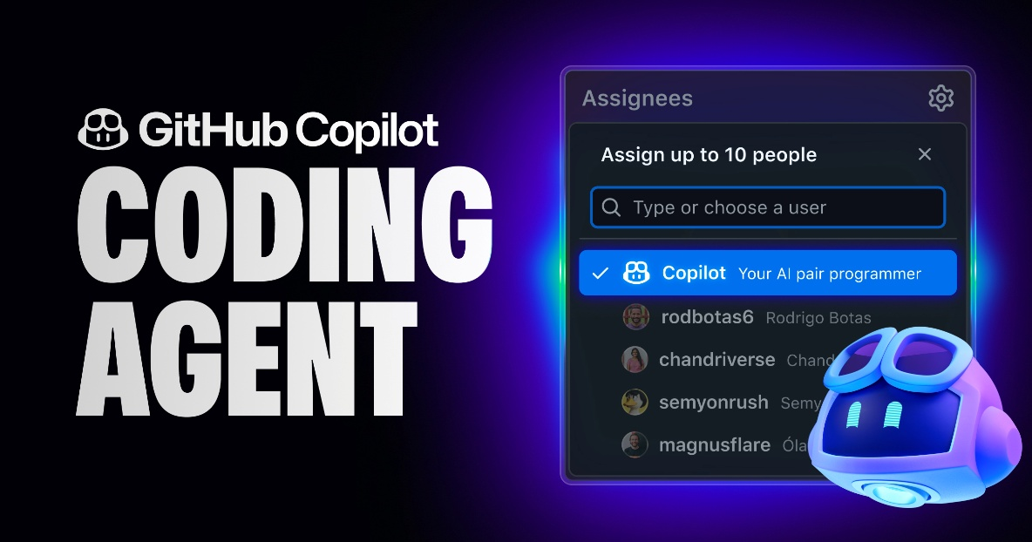
Agent क्या है
An Agent is an AI system that can understand your goals, analyze the situation, decide what steps to take, and complete tasks on your behalf — often using tools, context, or actions.
Agent is the default chat mode. who can:
Understand your project context
See open files
Read error messages
Reason about your codebase
Provide explanations, suggestions, and solutions

Slide 16
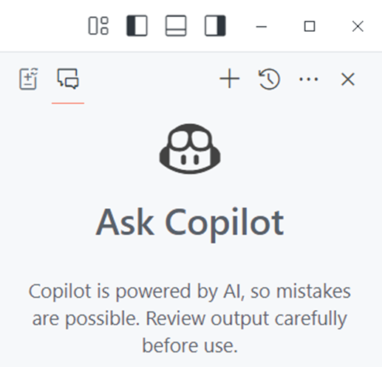
Explain, Debug & Improve Code with Copilot
Use Ask Mode to explain unfamiliar code: it summarises logic, complexity and intent. Describe error messages or stack traces to receive debugging suggestions. Ask for alternative implementations to improve readability or performance. Example: "Refactor this loop to use recursion" yields an alternative function. Always validate suggestions by running tests after applying them.

Slide 17
create step-by-step implementation plans
Plan mode in GitHub Copilot Chat is a feature designed to help users create detailed, step-by-step implementation plans for software development tasks before any code is written.
Select Plan Mode: Open Plan Mode inside Copilot Chat in your IDE
Describe Your Task: Give a high-level overview of what you want (new feature, refactor, or bug fix.)
Copilot Creates a Plan: It analyzes your project and generates a step-by-step action plan.
Refine the Plan: Copilot may ask questions; you can edit, clarify, or adjust the plan.
Implement or Export: Approve the plan to let Copilot start implementing it.

Slide 18
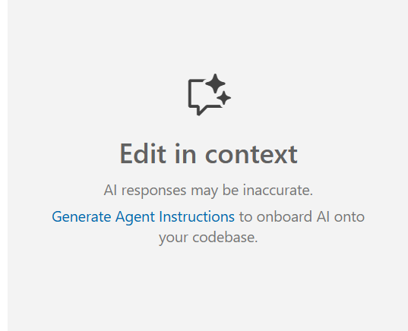
Edit Mode
Edit mode is for direct code transformation inside your file.
You select a piece of code → Copilot edits it according to your prompt.
What it can do
Rewrite code
Optimize logic
Add comments
Add error handling
Convert code (JS → TS, Python → JS, etc.)
Fix performance issues
Apply coding style guidelines

Slide 19

Vibe Coding
Chat-Driven Code Generation
(Natural Language → Code)

Slide 20
Vibe Coding क्या है
Vibe coding means describing desired functionality in plain language to generate code.
Works best for small, well‑scoped tasks; avoid ambiguous or open‑ended prompts. Examples: "Create a function to reverse a string" or "Generate HTML for a login form". Limitations: complex requirements may be misinterpreted; refine prompts accordingly. Balance automation with manual coding to maintain control over logic.

Slide 21
Prompting
A prompt is simply the instruction you give to the AI to make it do something. Think of it like giving directions to a very fast, very literal assistant. If your instructions are clear, you’ll get exactly what you need
For better prompt follow C-A-O. That is context, Action and Output
You should provide a clear Context –which gives clear understanding of What’s the situation or background?
Then the Action should be clear in the prompt– that is What do you want the AI to do? you should mention that in the prompt
And finally Output – What format should the response take? Like a chart, a report a table a summary this could be anything.

Slide 22
Iterative Refinement
Start with
Clear Prompt
Evaluate
Output
Refine
Prompt
Repeat
& Iterate
Benefit | Why It Matters
Enhanced Accuracy | Clarifies ambiguous instructions, reducing errors and strengthening factual grounding.
Optimized Reasoning | Supports complex tasks and analytical problem solving through step‑by‑step reasoning.
Reduced Hallucinations | Maintains factual consistency and minimizes irrelevant responses.
Production‑Ready AI | Aligns outputs with business objectives and ensures reliable deployment.
Iterative refinement turns prompting into a feedback‑driven loop a disciplined process of evaluation, adjustment and repetition that yields high‑quality, context‑aware outputs.

Slide 23

Agentic Coding
Fully autonomous dev agent Development

Slide 24
What is Agentic Coding?
Agentic coding is a software development process where AI agents actively participate in the coding process:
🤖 AI-Powered Assistance – Intelligent agents that understand context and intent
🧩 Interactive Development – Real-time collaboration between human and AI
🎯 Task-Oriented – Agents that can complete complex, multi-step programming tasks
🧠 Context Awareness – Understanding of codebase structure, patterns, and conventions
Instead of just suggesting code, agents actively participate in planning, implementing, and refining solutions.

Slide 25
Vibe Coding Vs Agentic Coding.
 | Vibe Coding | Agentic Coding
Autonomy | Conversational co‑pilot | Fully autonomous dev agent
Human role | Continuous steering | High‑level supervisor
Sweet spot | Rapid prototypes, green‑field apps | Large refactors, CI/CD maintenance
Risk | Lower every change is reviewed live | Higher silent failures possible
Tool examples | ChatGPT, Cursor, Ghostwriter | Devin 2.0, Copilot Agent

